Slide 1
DDS For Live Session
UNIT 1

Slide 2
Flow of Live Session
Introductions (15 min)
Syllabus Questions and Brief Overview (10 min)
Data Science News of the Week (DSNOW) (10 min)
DSNOW drawing for the semester (2 min)
Show compiled data science profile bar charts (5 min)
You will need to compile these from the pptxs.
Show library resources
Break Out 1 – T-Test (20 min)
Give students 10 (ish) minutes to present and discuss their work
Bring them back in and run through the markdown for this unit.
Break Out 2 – CLT (20 min)
Give students 10 (ish) minutes to present and discuss their work
Bring them back in and go through solution on slide. You may need to or want to go out to R as well.

Slide 3
Data Science News of the Week!

Slide 4
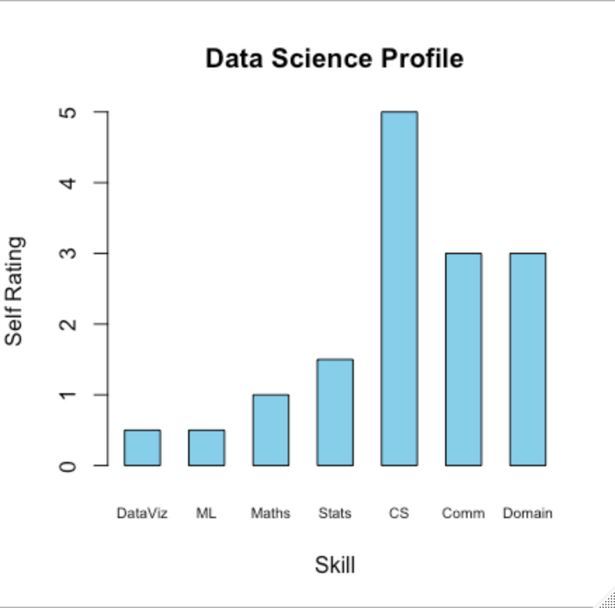
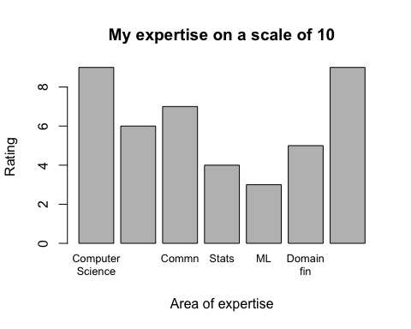
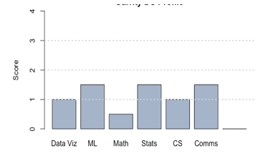
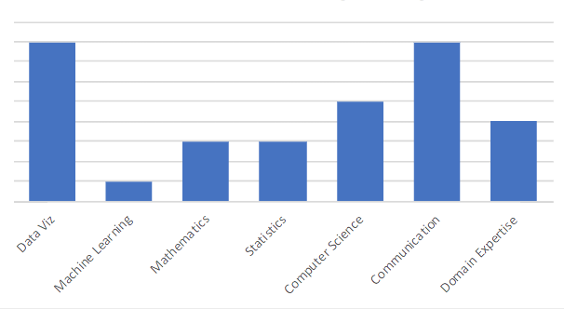
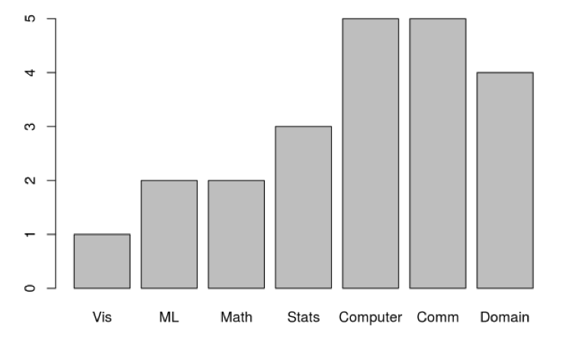
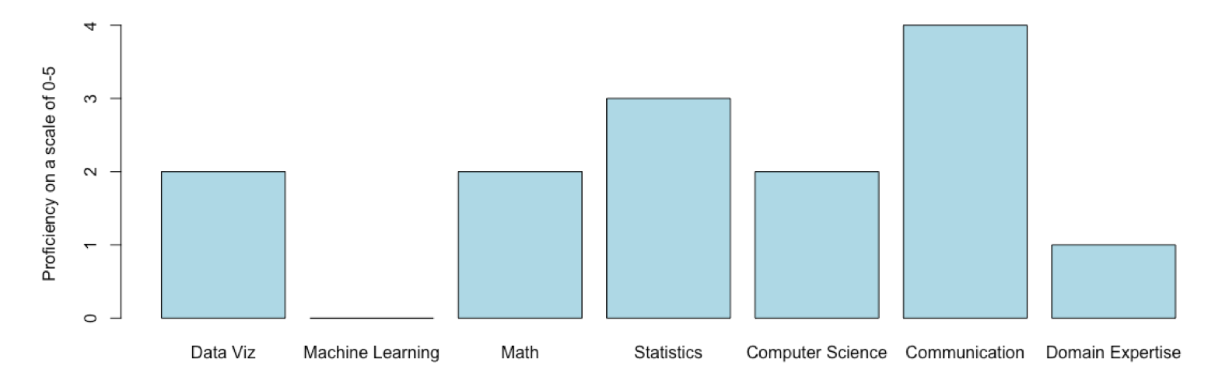
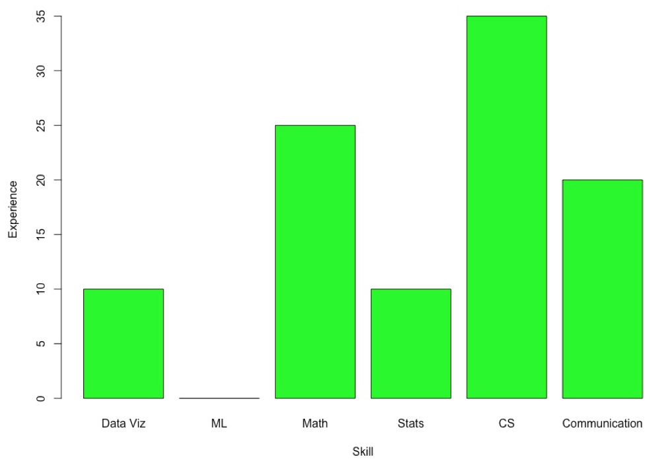
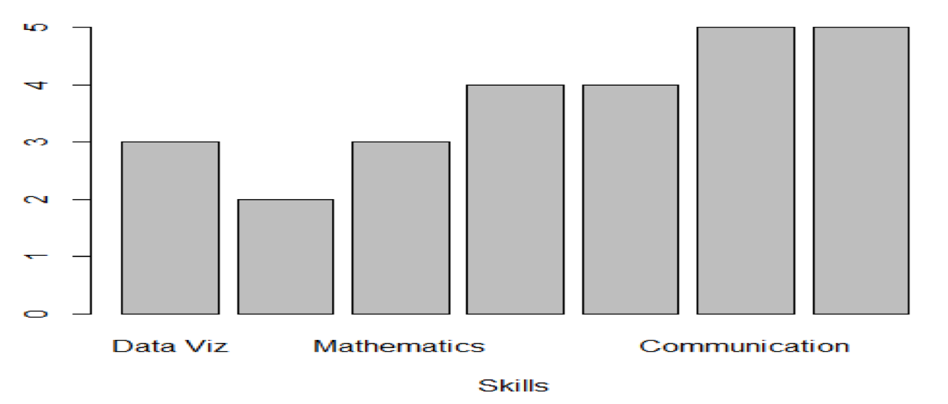
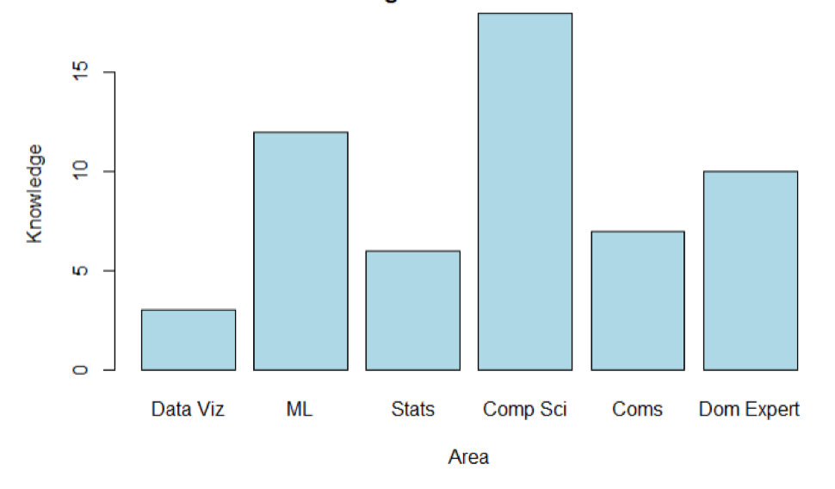
Data Science Profiles!

Slide 5
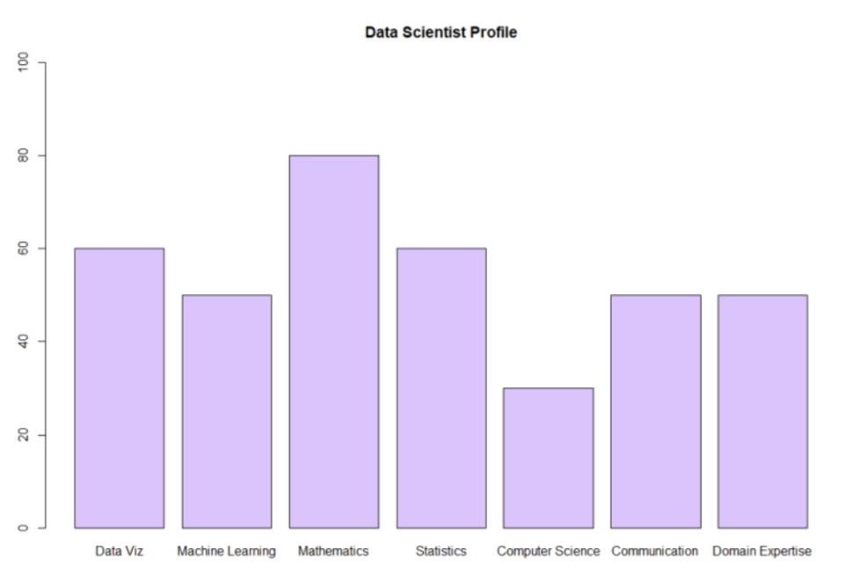
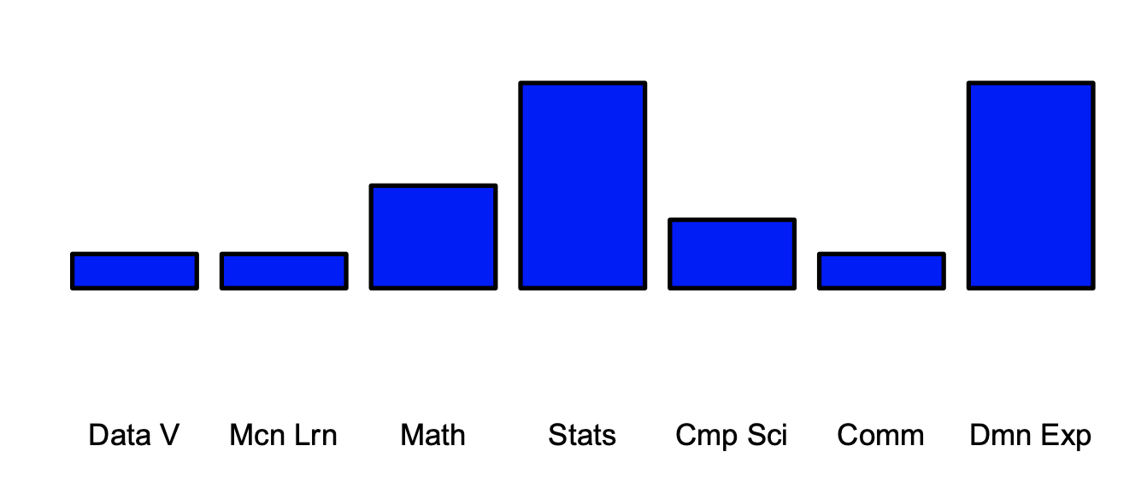
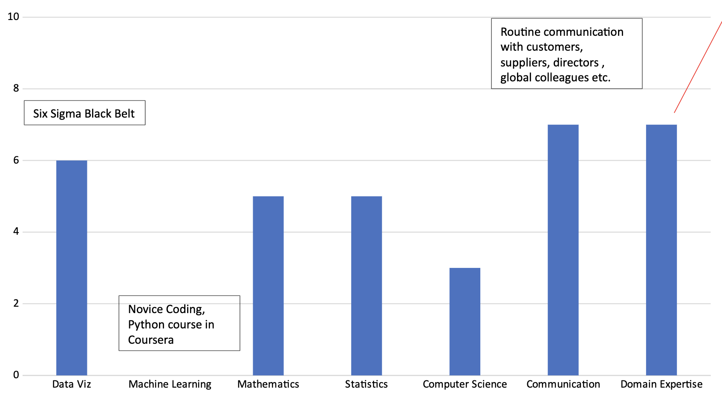
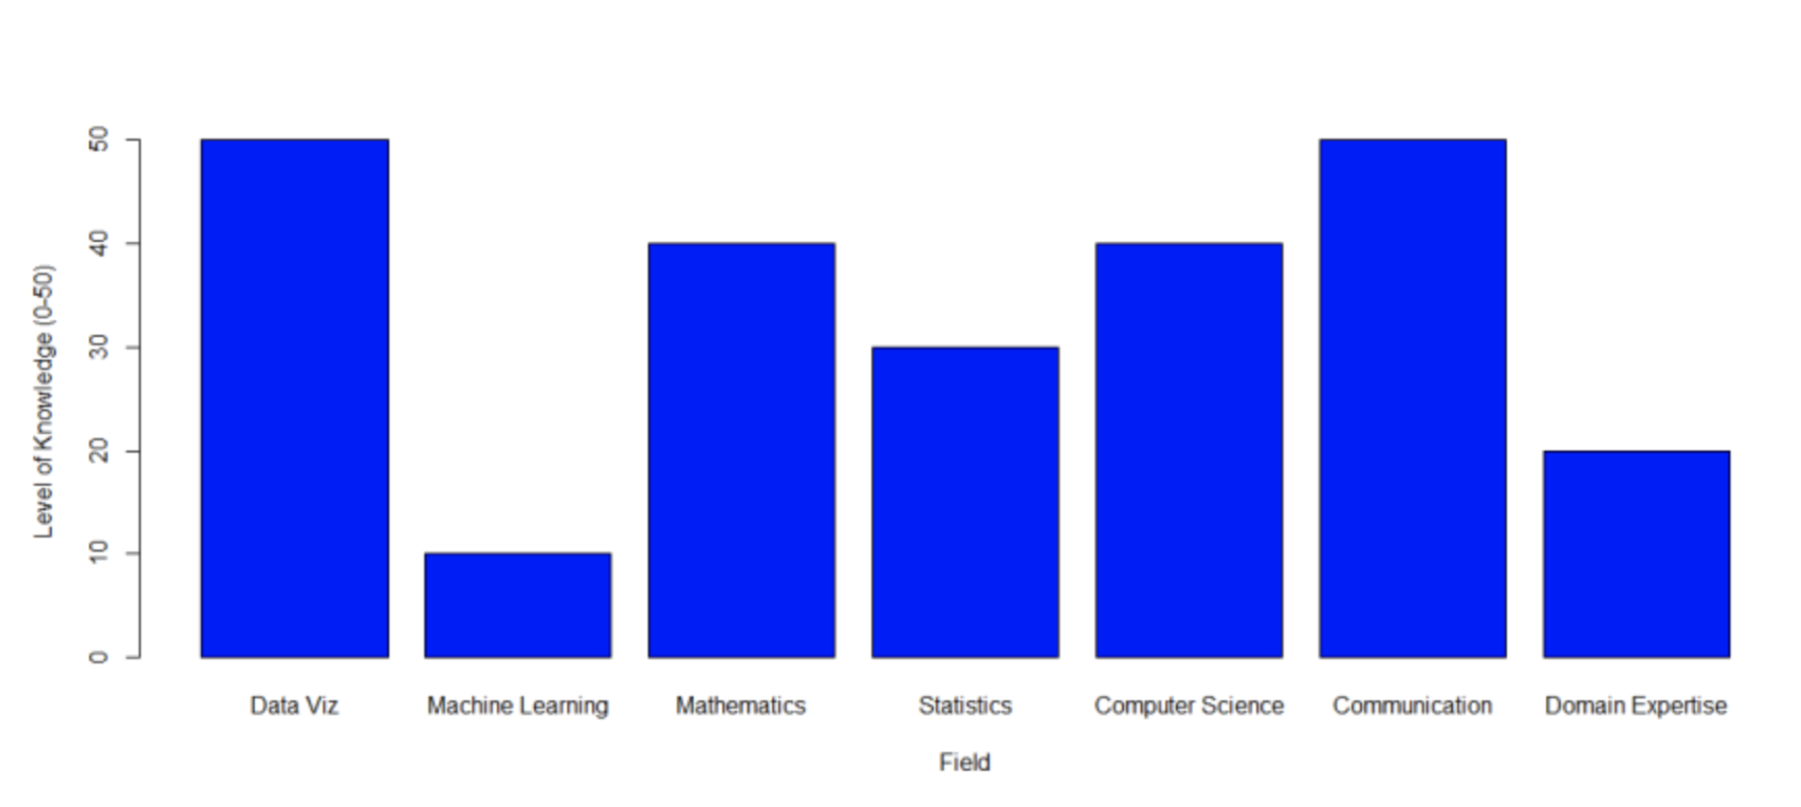
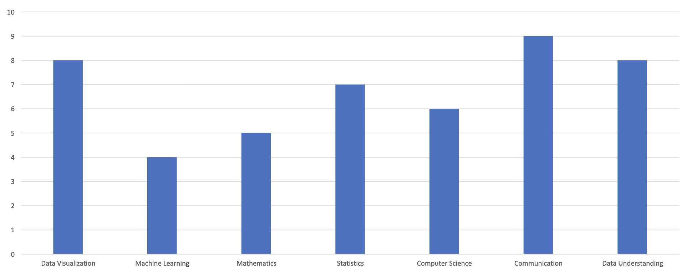
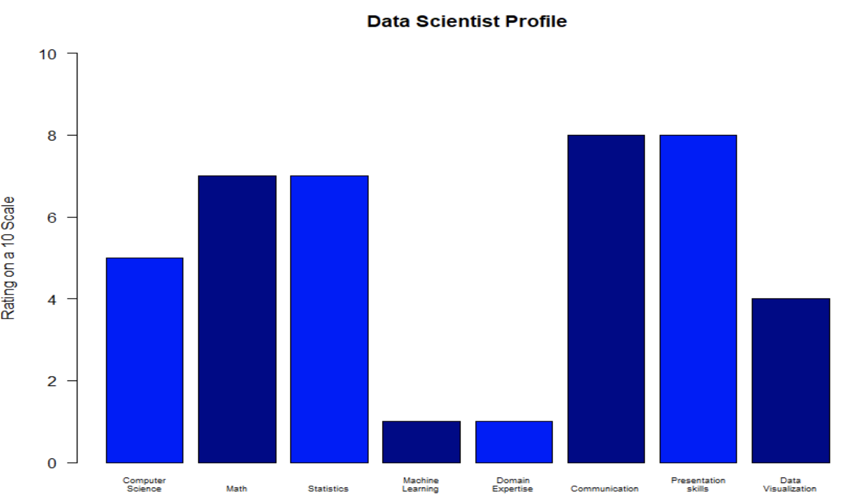
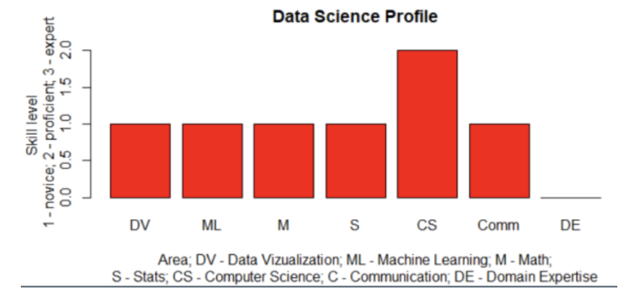
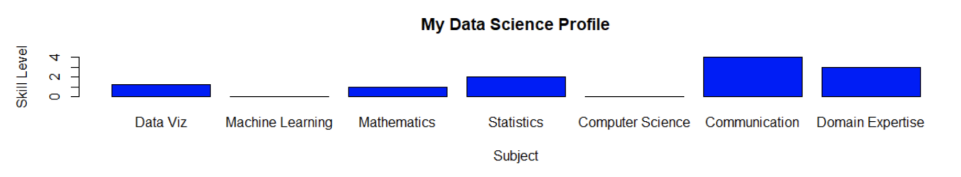
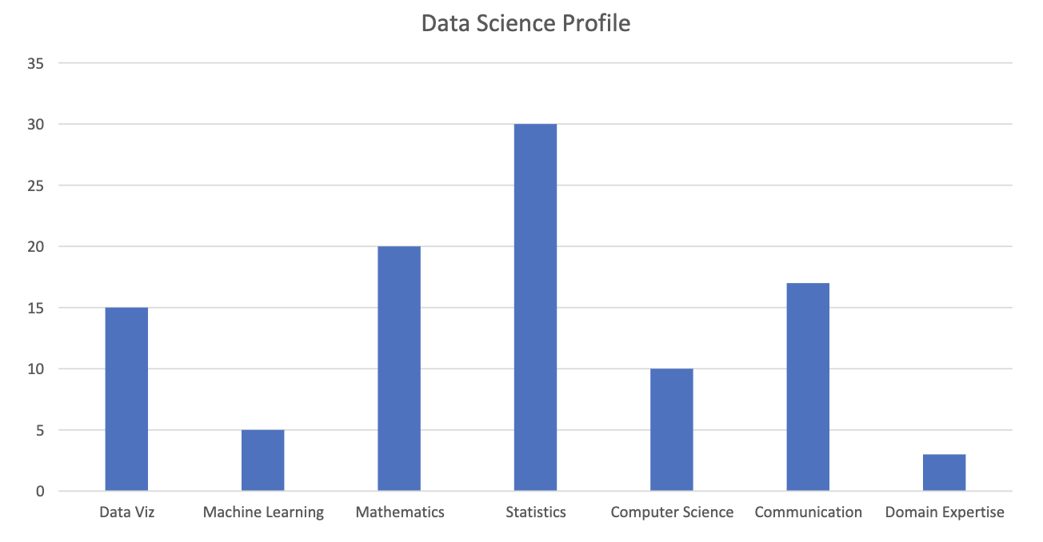
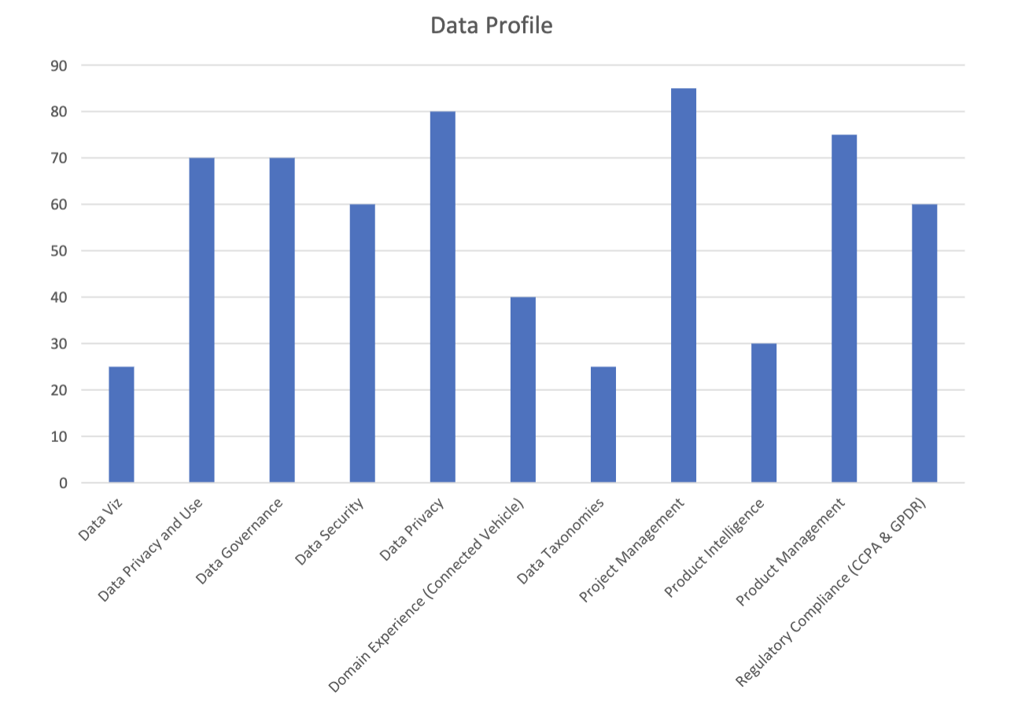
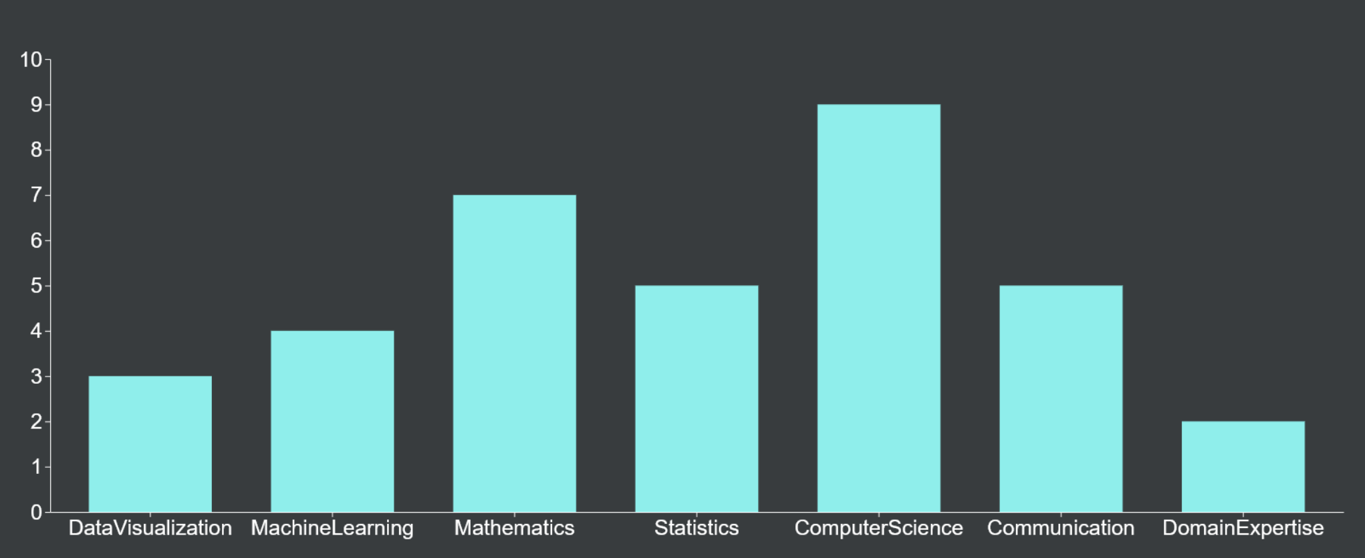
Our Data Science Profiles!

Slide 6
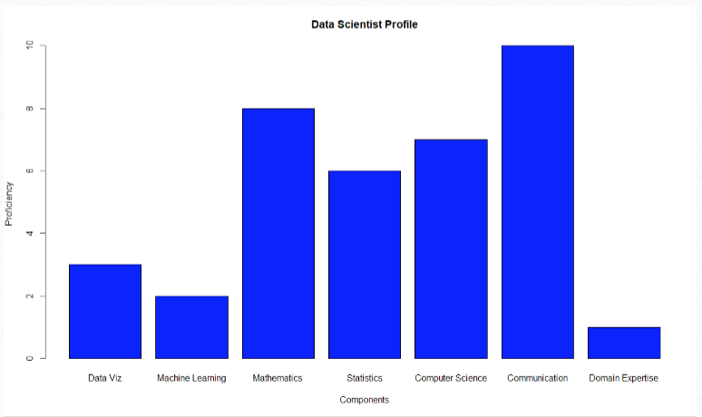
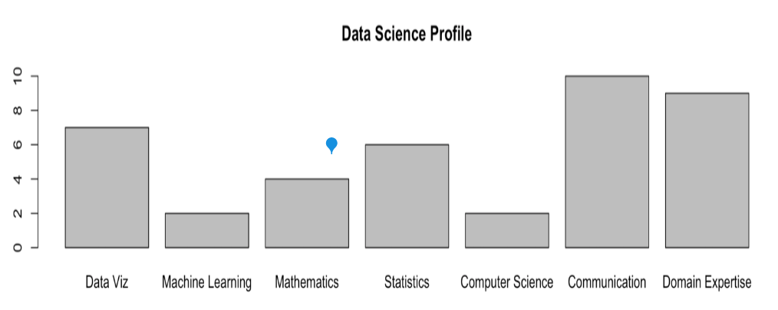
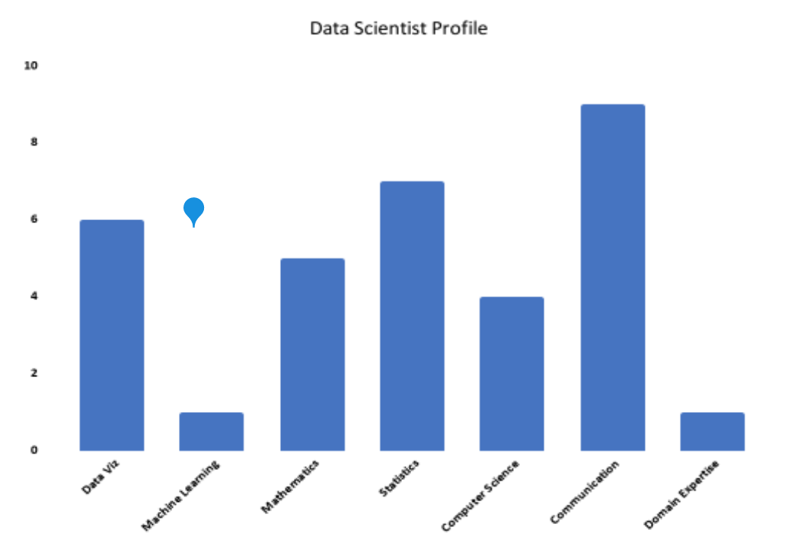
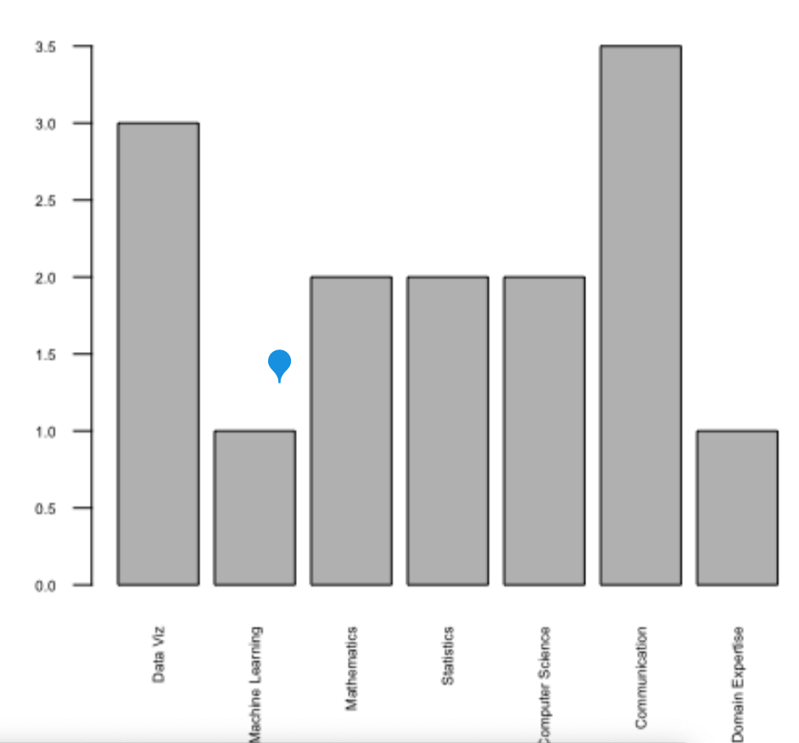
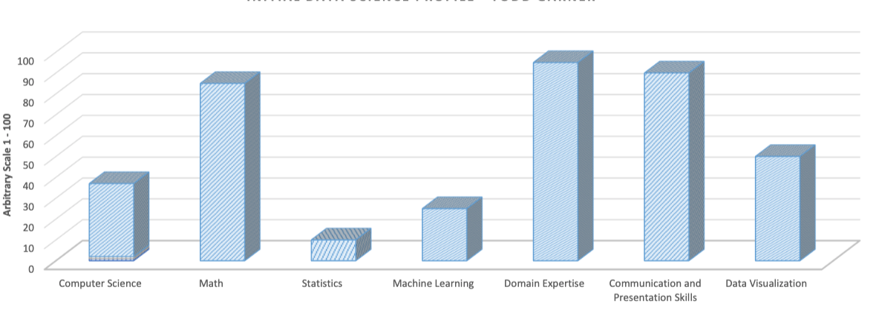
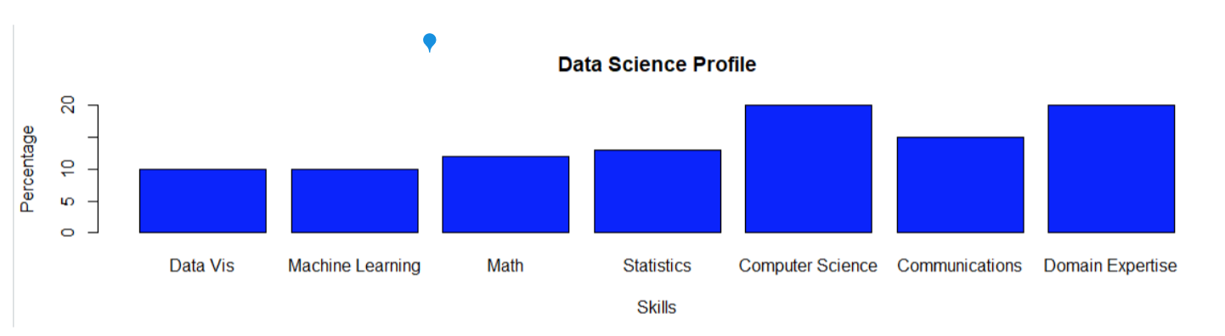
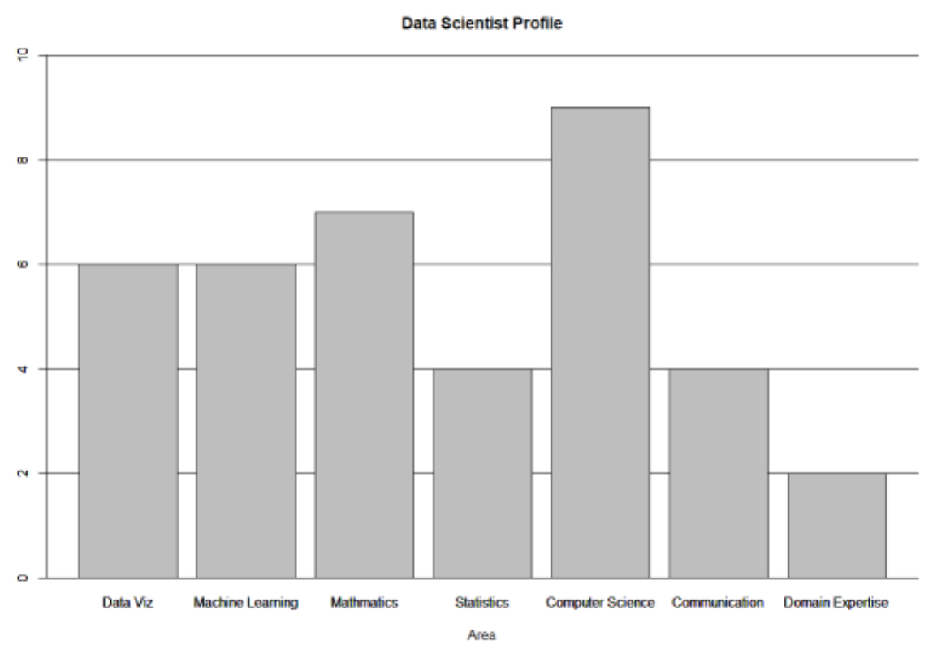
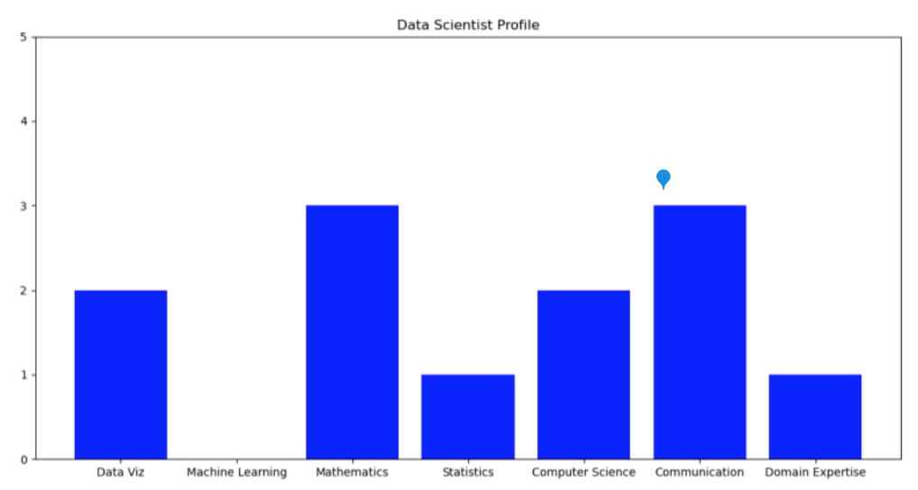
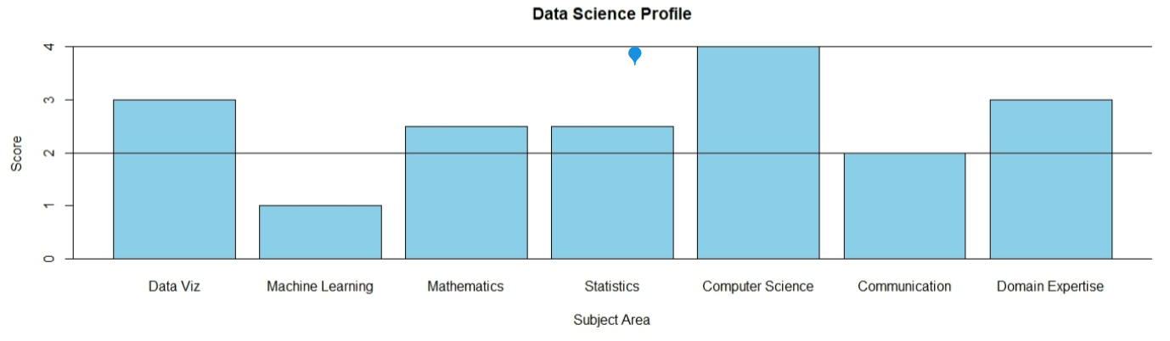
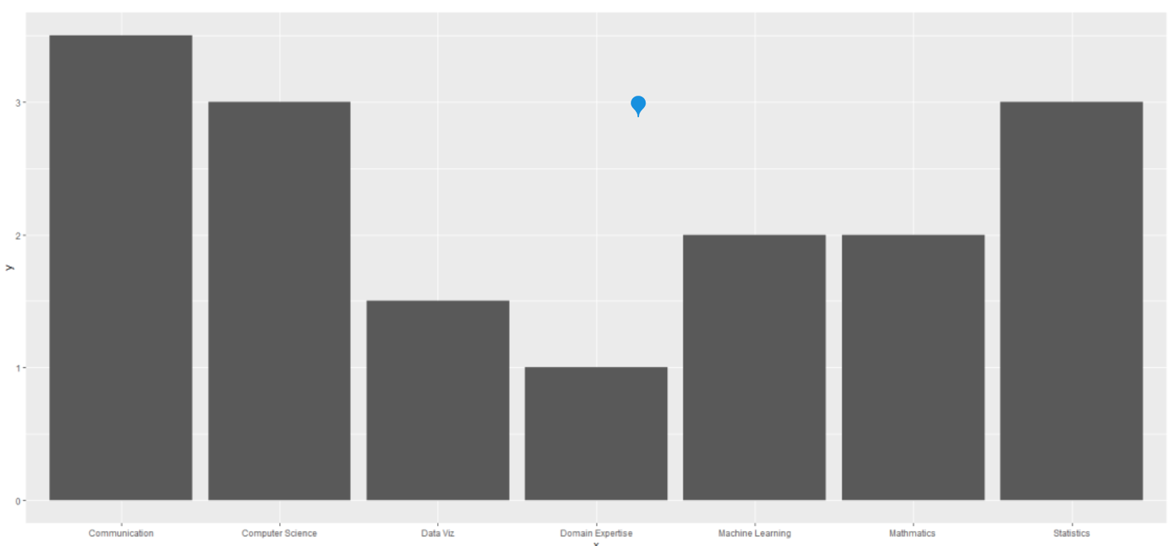
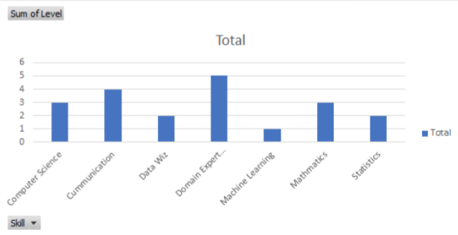
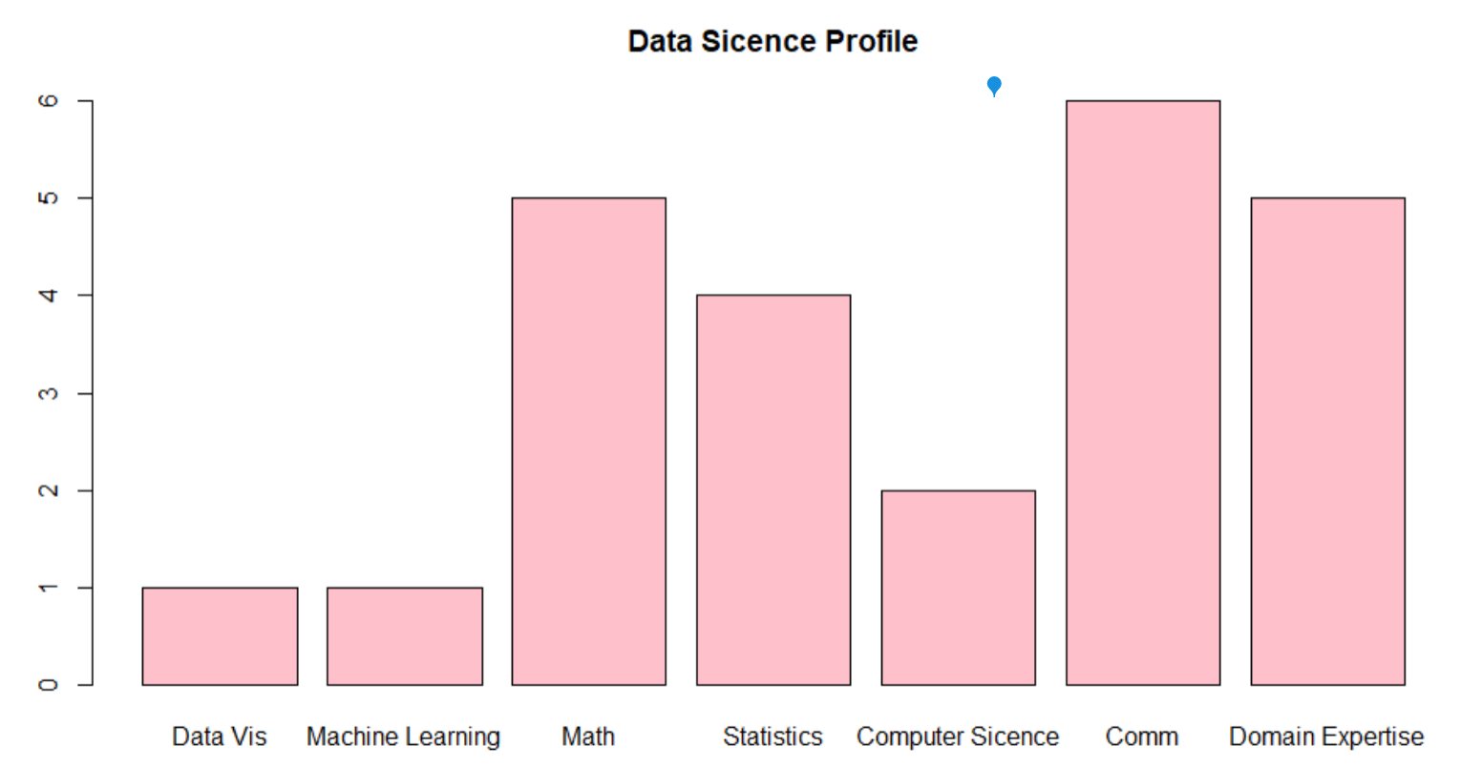
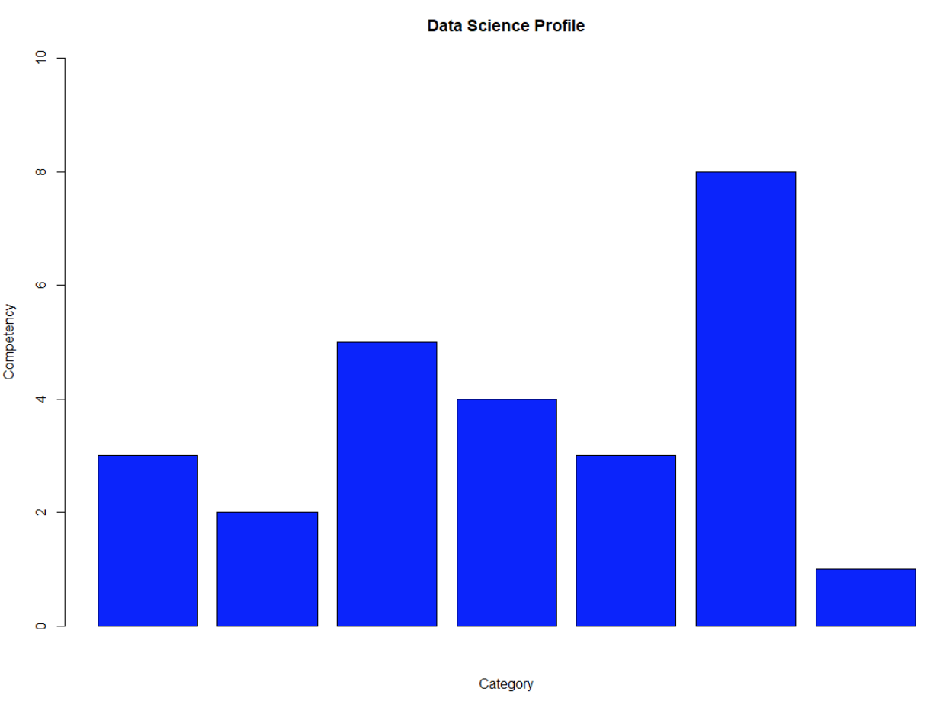
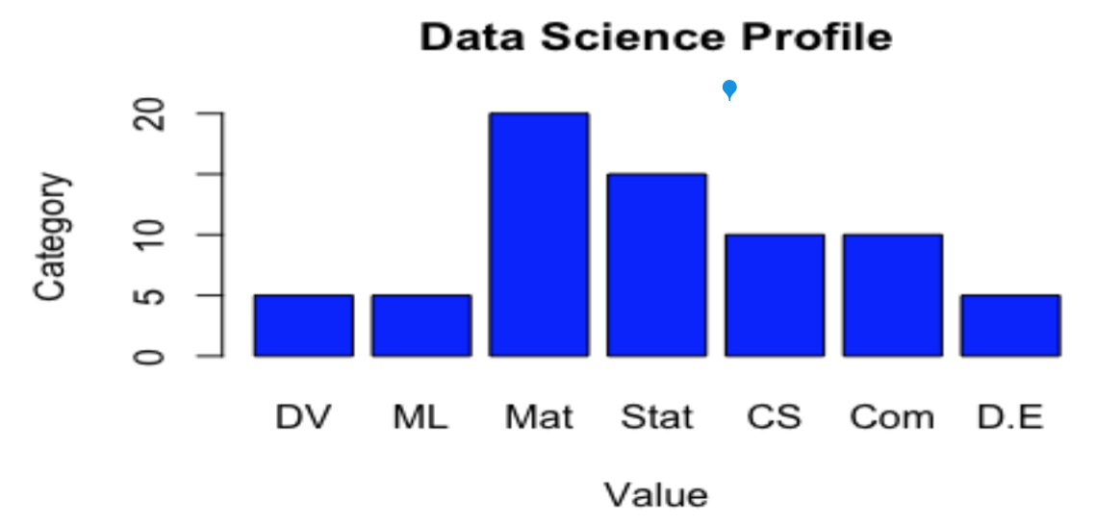
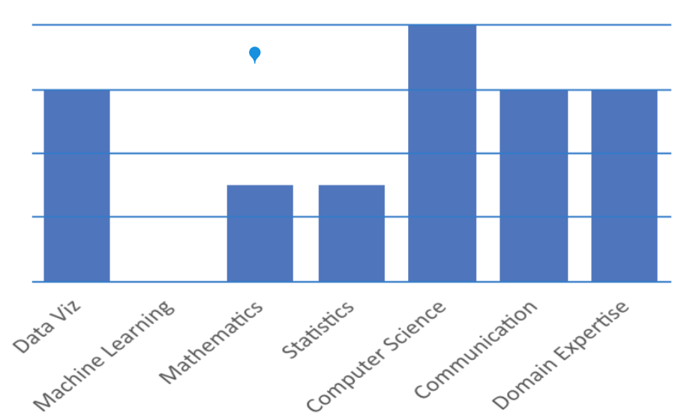
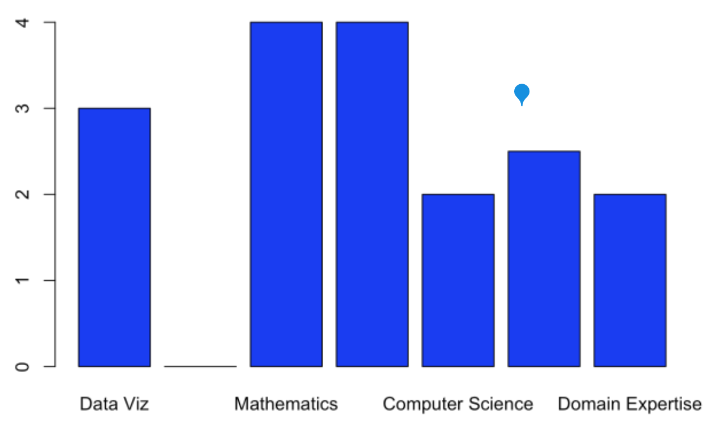
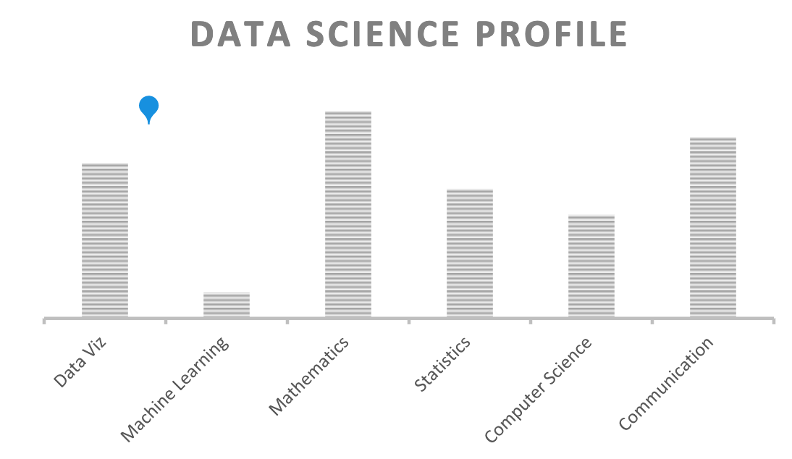
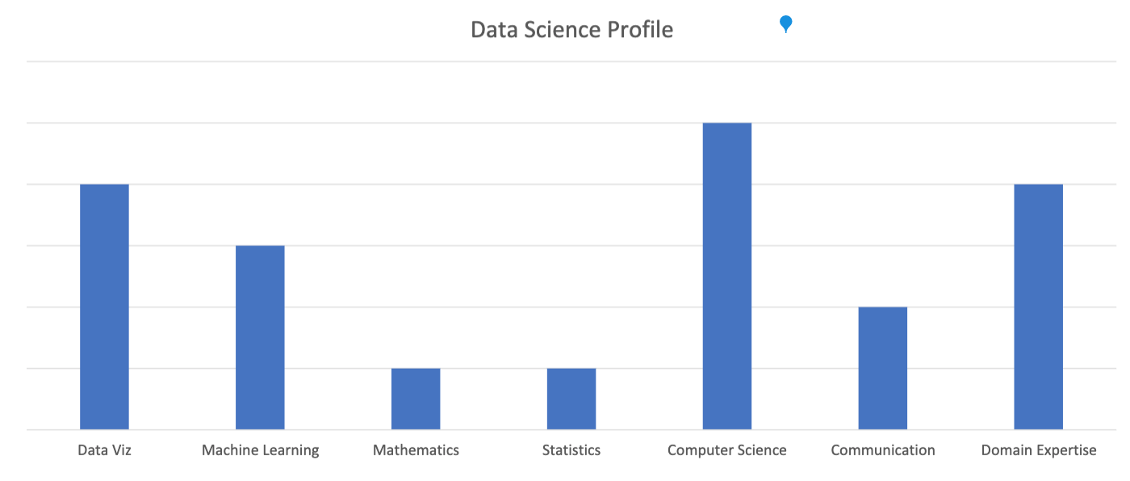
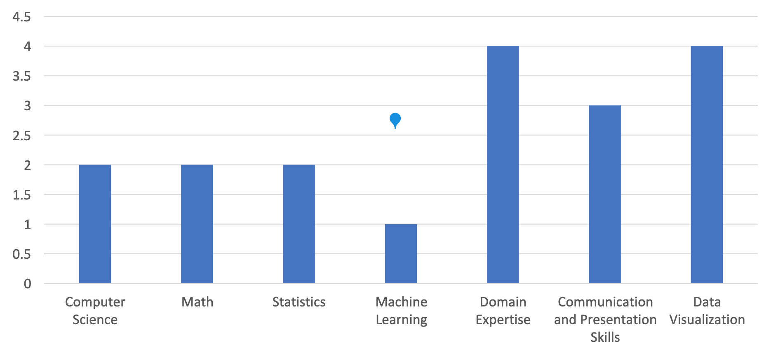
Out Data Profiles!

Slide 7
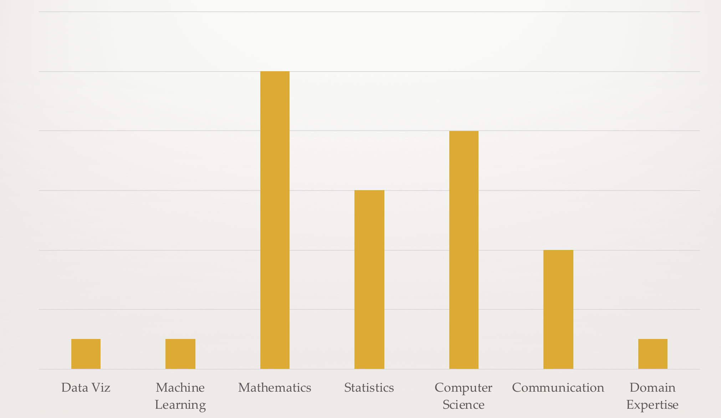
Data Science Profile 20 Year Ago

Slide 8
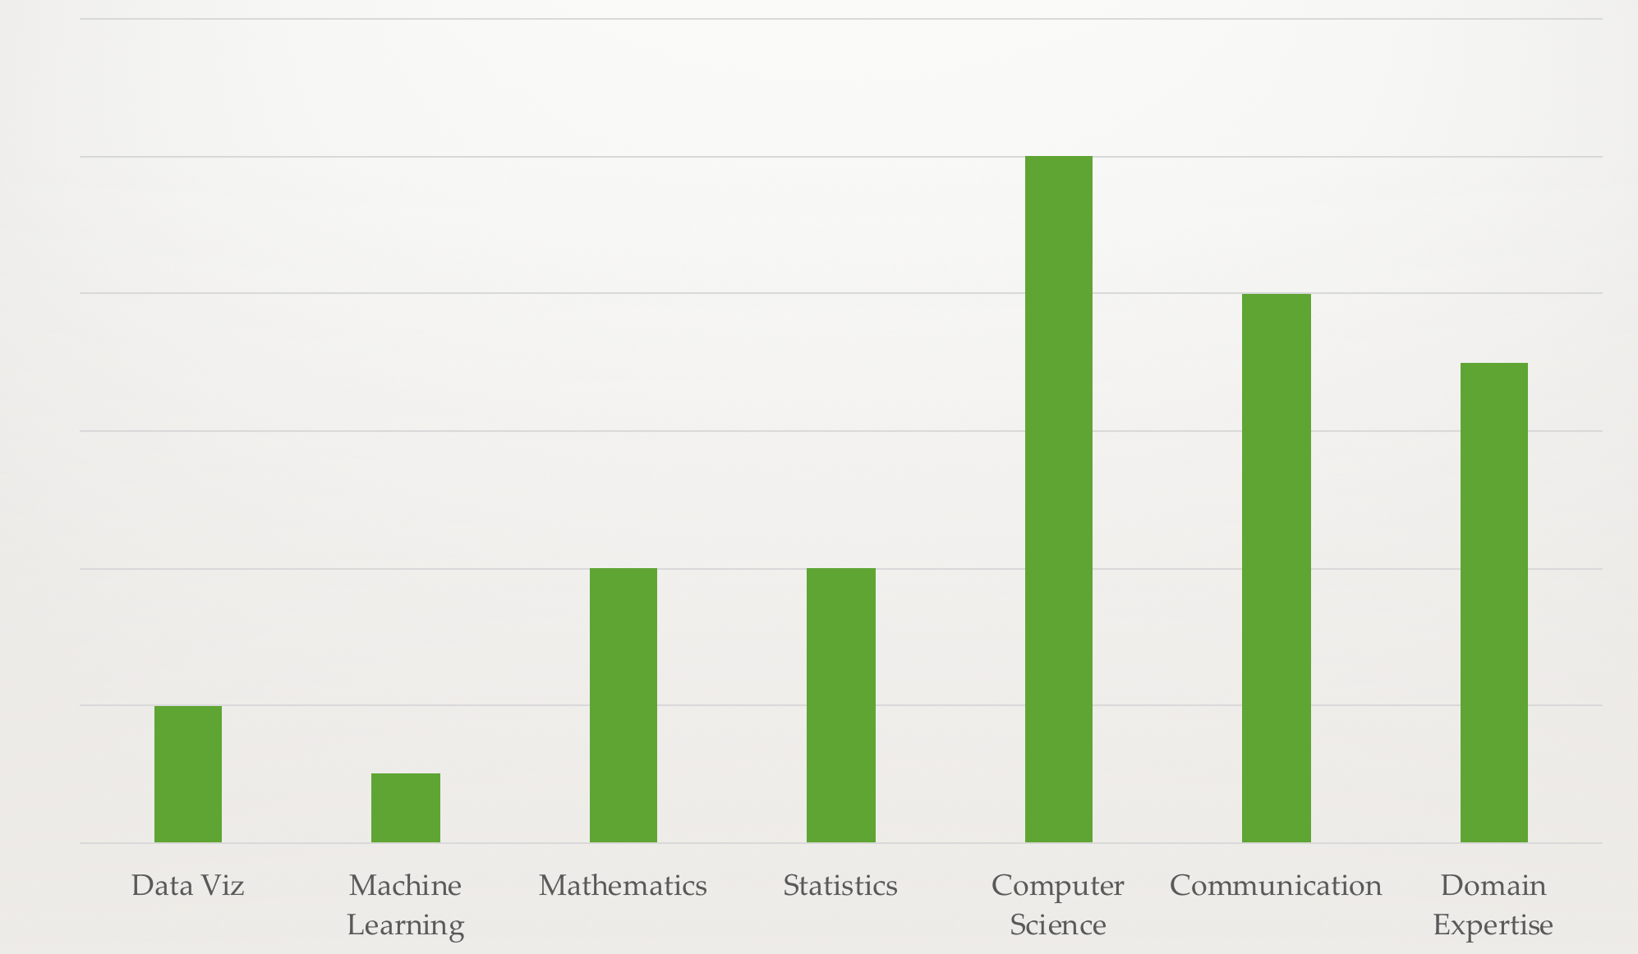

Data Science Profile Today!

Slide 9
For Live Session: Unit 1 Due at 1pm CST the day of live session.
For each number, provide at least 1 Powerpoint slide to provide a clear presentation of your response. You will present most of these slides in a break out and are given a score based on their completeness and clarity. Most importantly, they will maximize your live session experience!
Data Science Profile: Make a bar plot for your data science profile.
CLT: Using the central limit code from the asynch material (CLT2.Rmd), adapt the code and provide the following analysis:
Adapt the code to generate a population of 10,000,000 from a chi-square distribution with 2 degrees of freedom. This is a heavily right skewed distribution. (Hint: rchisq()). You will have to read up on this function and probably do some trial and error. Being able to learn new functions and methods is a key skill.
Provide a histogram of this population… display the right skewness.
Record the mean and standard deviation of this population.
According to the central limit theorem, what should be the approximate distribution of sample means of size 50 from this right skewed population? What should be the mean and standard error of the mean (standard deviation of the distribution of sample means)?
Now let’s check this: Adapt the CLT code to draw 10,000 means each of size 50 from this population and provide the sampling distribution of this sample mean. Provide a histogram of these 10,000 sample means.
What is the mean and standard deviation of these 10,000 sample means?
T-Test
Research in R how to conduct a T-test (t.test) and conduct a six step hypothesis test to answer the question on the next slide. If you would like to brush up on hypothesis tests, please see the Bridge Course for Statistics.
Takeaways and/or Questions: What were your key – takeaways from from this unit and what were any question or comments you would like to make? Your professor will use these to customize live session.

Slide 10
Answer to Break Out 1 Run through R markdown code.

Slide 11
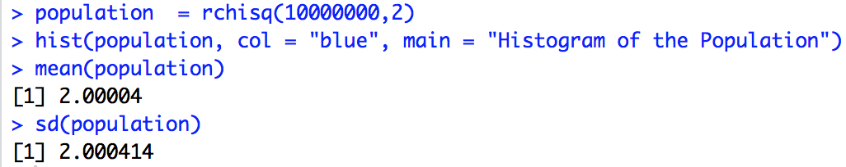
Distribution of the Population
For Internal Presentation
Client Presentation
Parameter | Value
Mean | 2.0
SD | 2.0

Slide 12
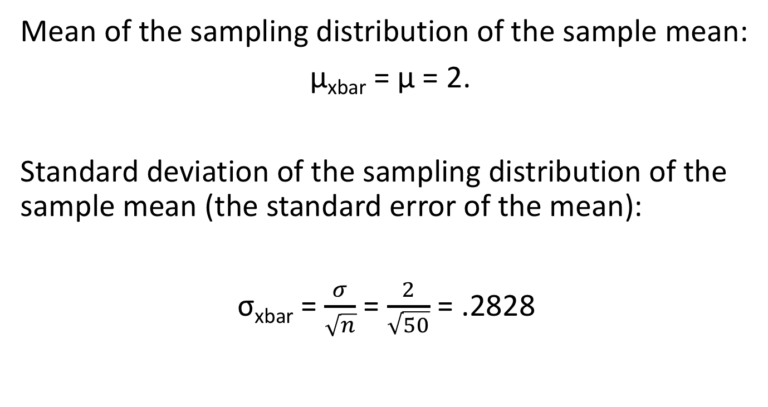
Theoretical Mean and Standard Error of the Mean
Mean of the sampling distribution of the sample mean:
μ_{xbar} = μ = 2.
Standard deviation of the sampling distribution of the sample mean (the standard error of the mean):
σ_{xbar} = $\frac{σ}{\sqrt{n}}$ = $\frac{2}{\sqrt{50}}$ = .2828

Slide 13
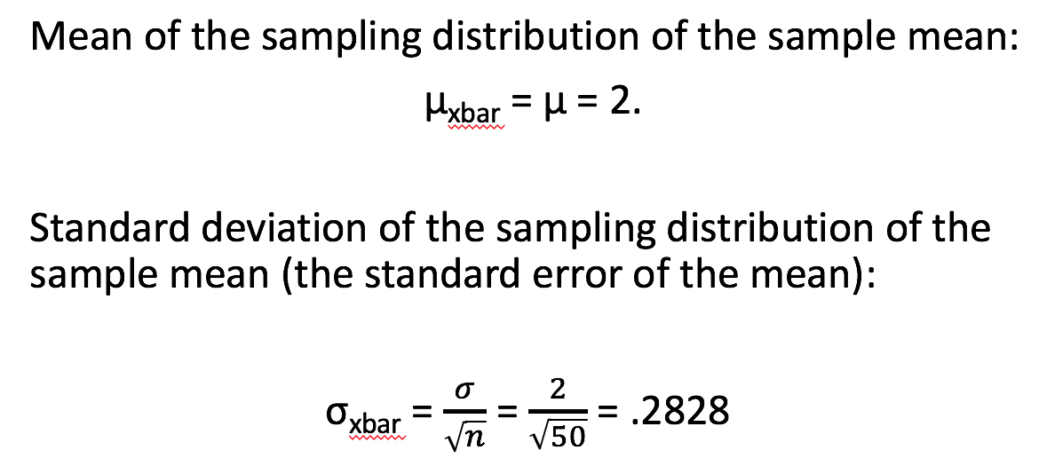
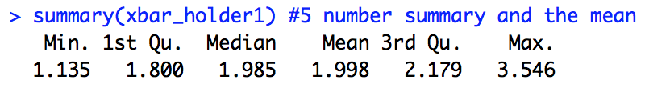
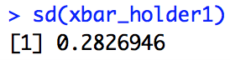
Confirmation from Simulation
THEORETICAL
SIMULATION
For Internal Presentation
Client Presentation
Parameter | Value
Mean | 1.998
SE | .2827

Slide 14
Answer to Break Out 2 Review the T-Test

Slide 15

1 Hypothesis Test
The following are ages of 7 randomly chosen patrons seen leaving the Beach Comber in South Mission Beach at 7pm! We assume that the data come from a normal distribution and would like to test the claim that the mean age of the distribution of Comber patrons is different than 21. Conduct a 6 step hypothesis test to test this claim.
25, 19, 37, 29, 40, 28, 31

Slide 16
Strategy of Hypothesis Testing
1. Make an Assumption
2. Gather Evidence
3. Calculate the probability that we would observe this evidence IF ASSUMPTION IS TRUE.
4. Make a decision…. If it is very unlikely we would observe the evidence we observed if the assumption were true then this is evidence AGAINST this assumption’s truth and we will decide the assumption is false. However, if the evidence is consistent with the assumption we made then we cannot conclude (decide) that the assumption is false.

Slide 17
Strategy of Hypothesis Testing
1. Make an Assumption (Ho)
2. Gather Evidence (data, xbar)
3. Calculate the probability that we would observe this evidence IF ASSUMPTION IS TRUE. (The Pvalue!)
Make a decision….
If it is very unlikely we would observe the evidence we observed if the assumption were true then this is evidence AGAINST this assumption’s truth and we will decide the assumption is false. (Reject the assumption … Reject Ho.)
However, if the evidence is consistent with the assumption we made then we cannot conclude (decide) that the assumption is false. (Fail to Reject the assumption … Fail to Reject Ho.)

Slide 18
1 Hypothesis Test
The following are ages of 7 randomly chosen patrons seen leaving the Beach Comber in South Mission Beach at 7pm! We assume that the data come from a normal distribution and would like to test the claim that the mean age of the distribution of Comber patrons is different than 21. Conduct a 6 step hypothesis test to test this claim.
25, 19, 37, 29, 40, 28, 31

Slide 19
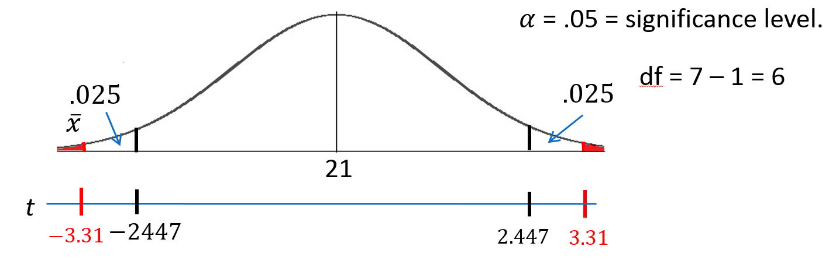
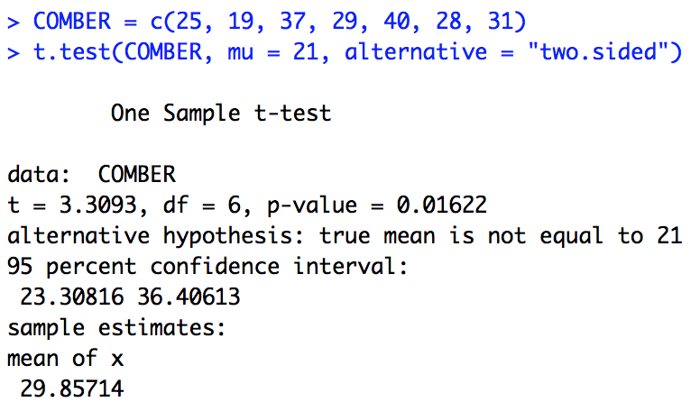
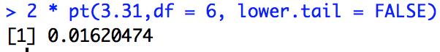
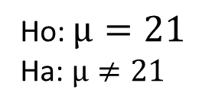


Revised Write Up!
We would like to test the claim that the population mean is greater than $4.$ To do this we take a sample of size n = 8 and find that $\overline{x}$ = 29.86 years and s = 7.09 years.
Ho: $µ=21$
Ha: $µ≠21$
Step 1: Identify the null (Ho) and alternative (Ha) hypothesis.
Step 2: Draw and Shade and Find the Critical Value.
$$t=\frac{\overline{x}−μ}{\frac{s}{\sqrt{n}}}$$
$$=\frac{29.86−21}{\frac{7.09}{\sqrt{7}}}$$
$$=3.31$$
Step 3: Find the test statistic. (The t value for the data.)
Step 4: Find the pvalue: Pvalue = .0162 < .05
Step 5: REJECT HO
Step 6: There is sufficient evidence to conclude that the true mean age of patrons at the Comber at 7pm is greater than 21 (pvalue =.0162 from a t-test).

Slide 20
CLT and the Beachcomber Problem
In your Breakout Group:
Adapt the CLT code generate sample means from a normal distribution with mean 28 and standard deviation 7 years.
Run another T-Test, this time testing the null hypothesis that the true mean age of patrons at the beach comber is 28. Does the pvalue reflect what you found in your simulation?
Repeat the above again for a true mean of 30. Does the CLT and the T-Test suggest that the data are consistent or inconsistent with a true mean age of patrons being 30?
Your client just asked you how are the CLT and T-Test are related? How do you respond?

Slide 21
So Important!!! Takeaways and Questions!!!

